Slide 1
Pen-y-Cwm School Senedd
17th January 2024
Presented by Lead Ambassadors

Slide 2
School Logo Senedd Design
Each sub-committee designed a logo – the logos together make up the Pen-y-Cwm Senedd Logo.

Slide 3
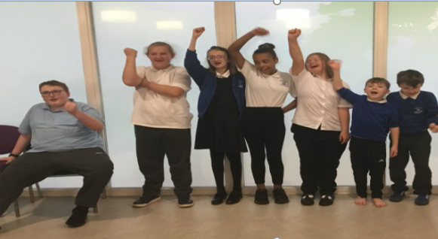
Eco Warriors
Next term, we are focusing on the following:
Recycling in classes
Upcycling to fundraise for our school to have more recycling bins
Saving electricity and water
Litter picking
Key events
Visit from John Mewett on recycling, litter and the environment.
Upcycling project

Slide 4
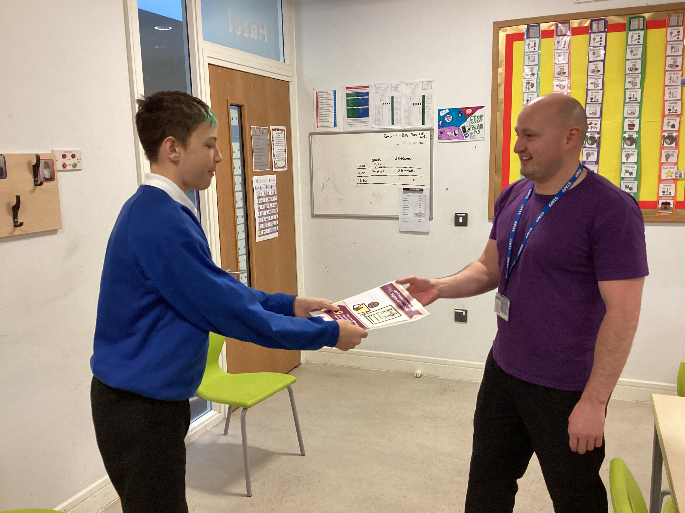
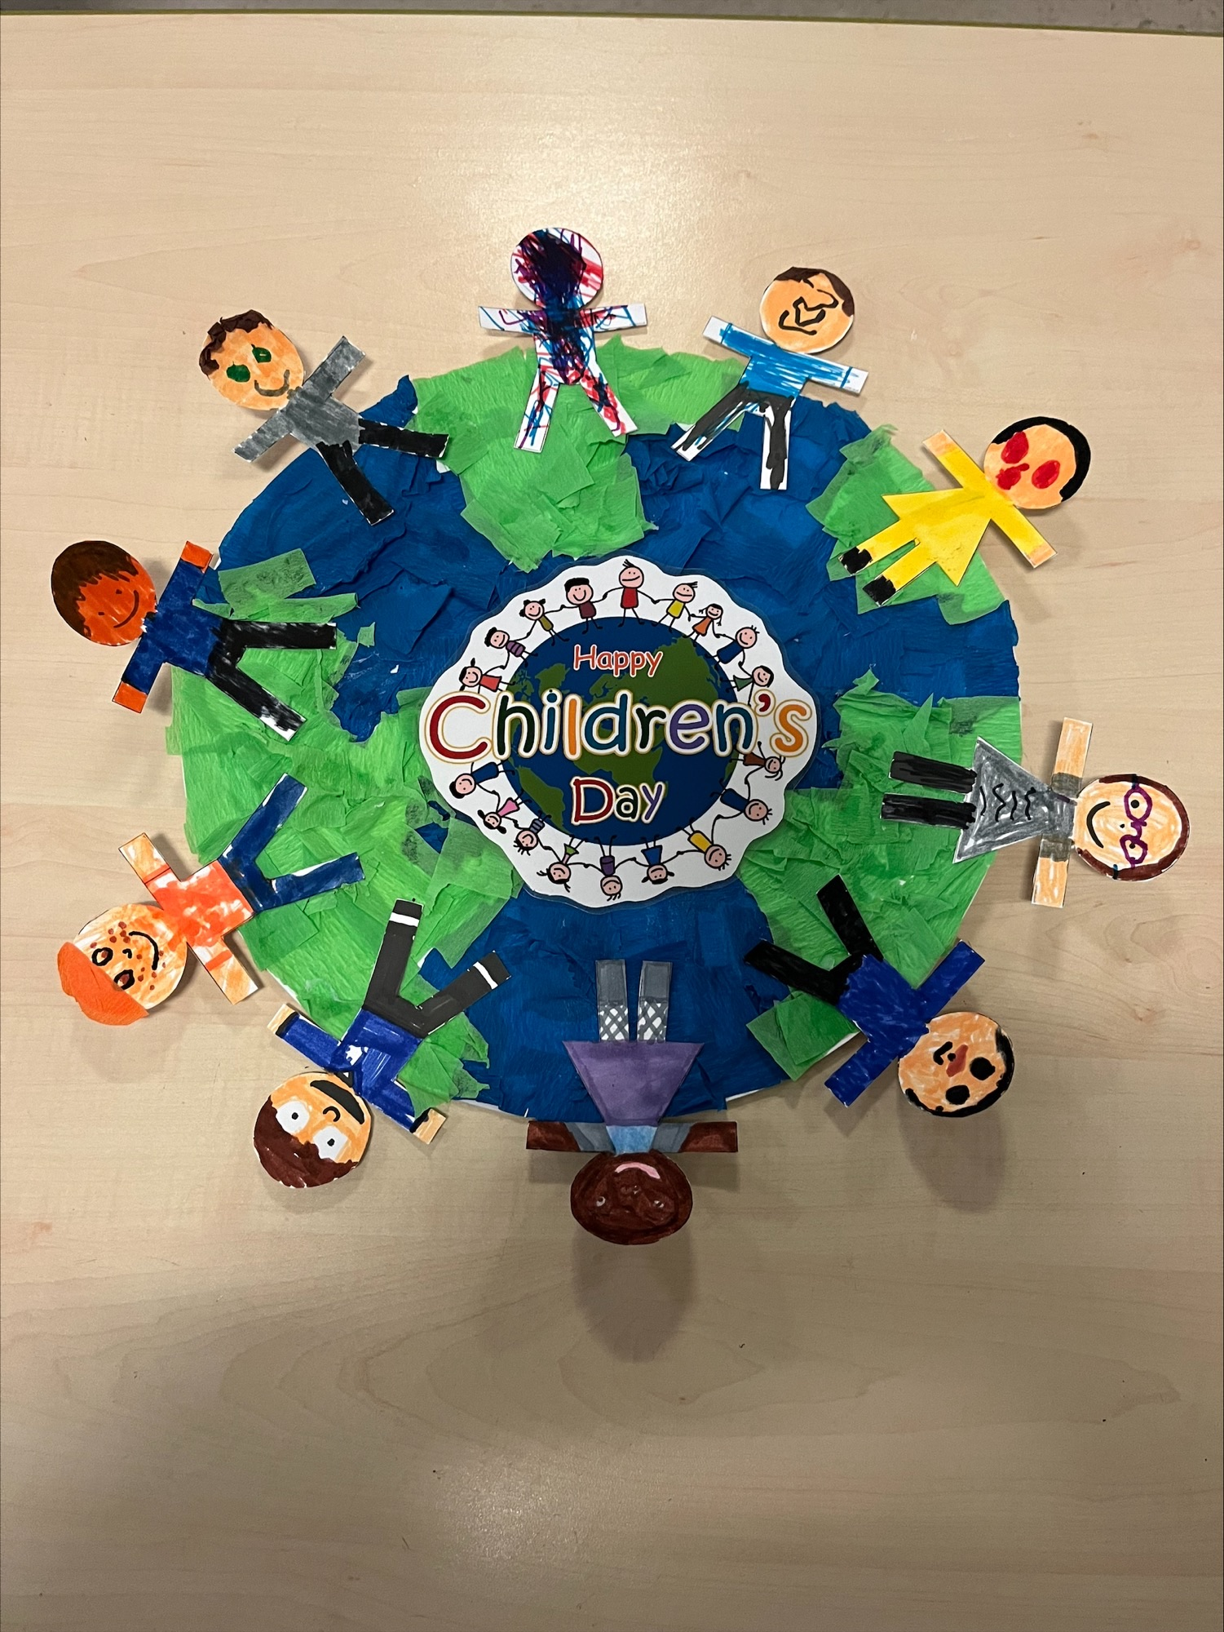
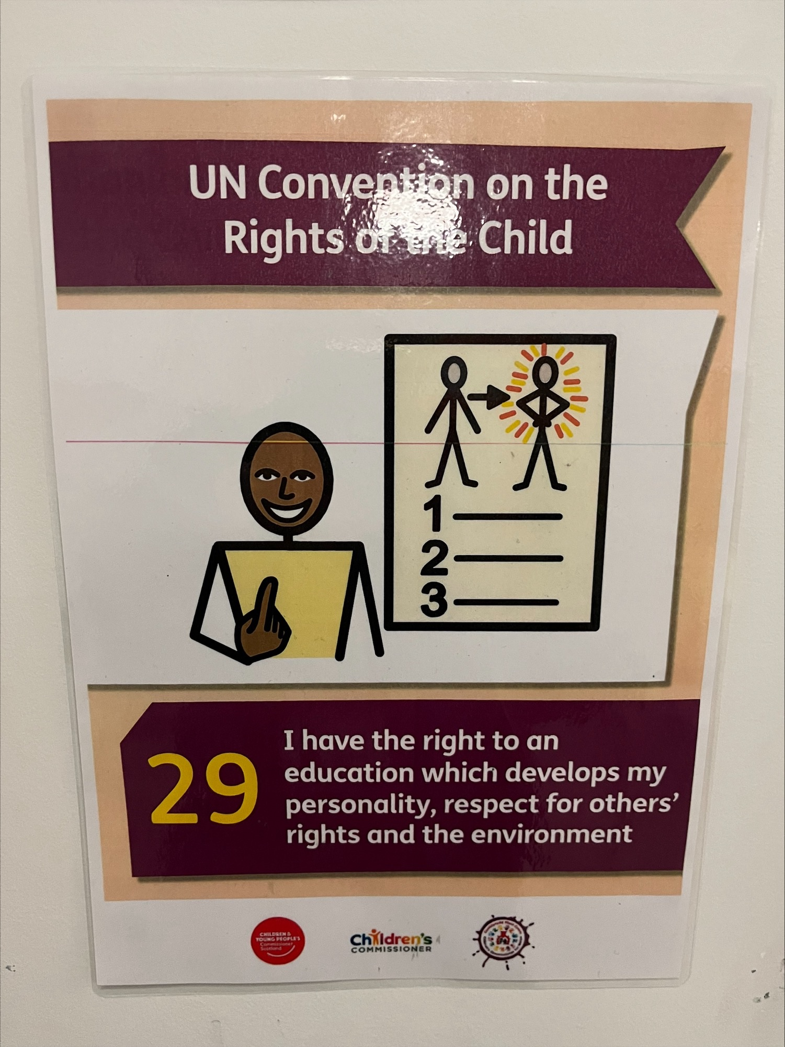
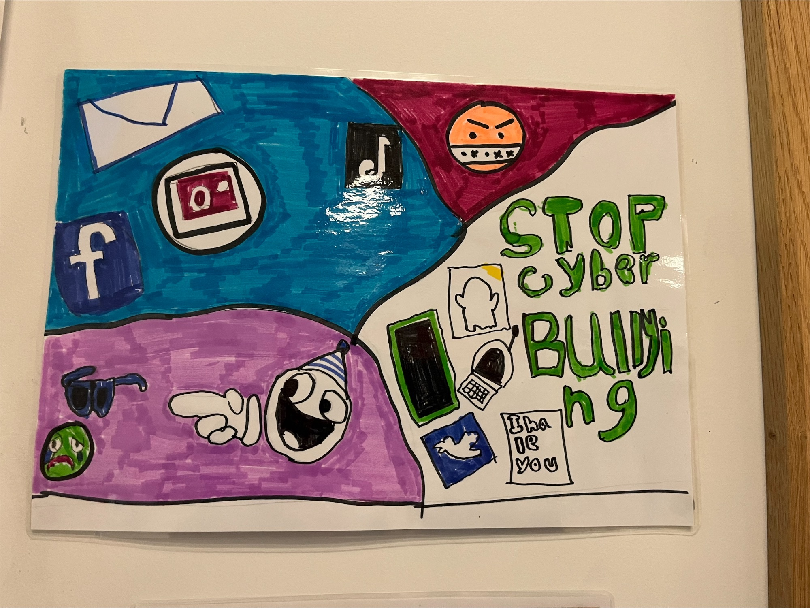
Rights Knights
Pen-y-Cwm is working on Silver Unicef Award for Rights and Respecting Schools.
An Article a month is circulated to every class in the school. So far we have had article 14, 19 and 29.
Rights Knights Responsibilities.
To become aware of the Unicef Silver Award accreditation.
To circulate the monthly articles – ensuring they are on display in every classroom.
Look for evidence of RRS on seesaw and class wall displays.
Assemblies – ensure that the article of the month is shared in every assembly.
Introduce the Rights Rainbow Teddy to every class.
RRS wall display to be updated.

Slide 5
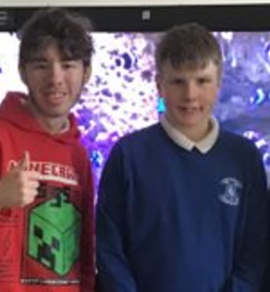
Digital Wizards
Roles/Responsibilities:
Plan, run and support Minecraft club.
Help classes with technology issues.
Upcoming events/focus:
16.1.24 2pm - Digital Strategy Meeting with Apple – Kristian Taylor
Scan our QR to see photographs and videos!

Slide 6
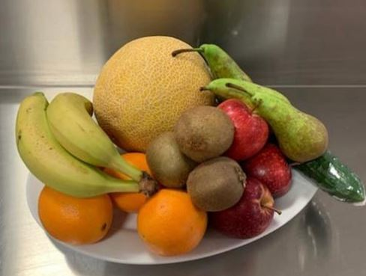
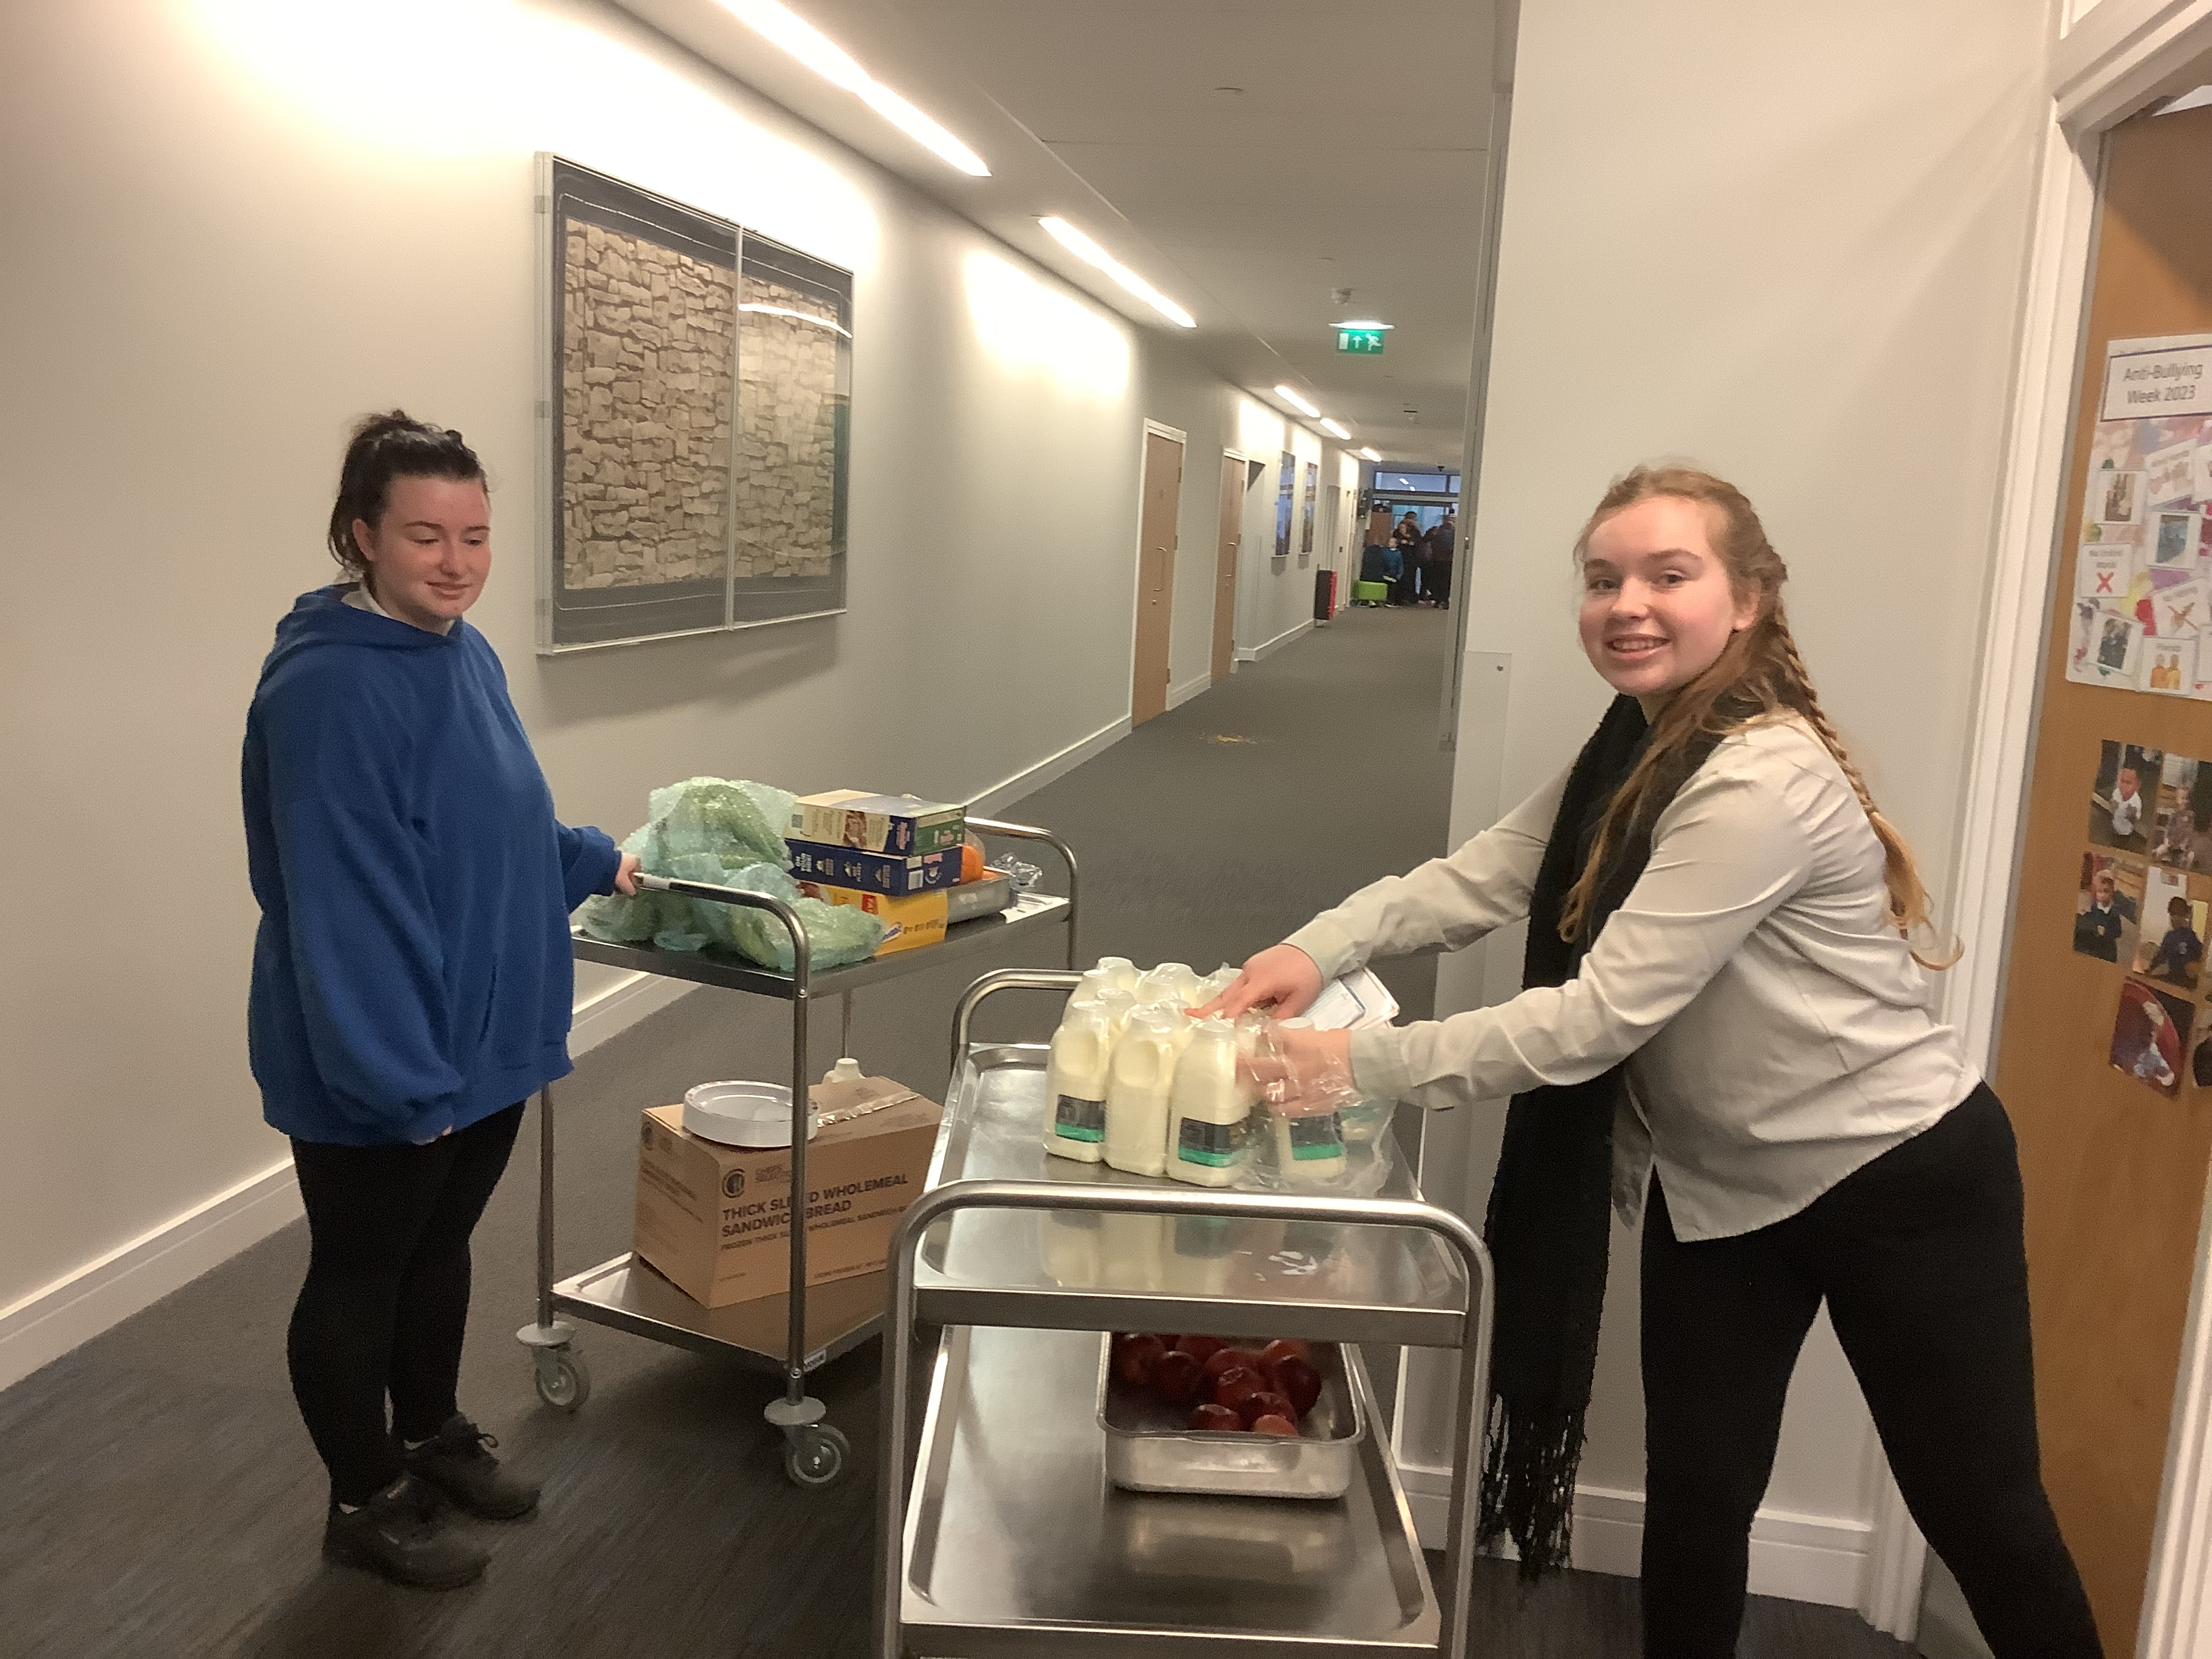
Healthy Heroes
Pen-y-Cwm follow the NQA Healthy
schools criteria.
This term the Healthy Heroes are working on:
Food and Fitness 11.1 - The Healthy Heroes are going to complete a survey on what is offered for the breakfast club to make sure we are all being offered Healthy options.
Ethos and Environment 8.1 - The Healthy Heroes are organising a competition with regards to creating posters for different subjects such as hand washing, kitchen hygiene, personal hygiene, food and drink storage, fruit tuck shops and storage of toothbrushes.

Slide 7
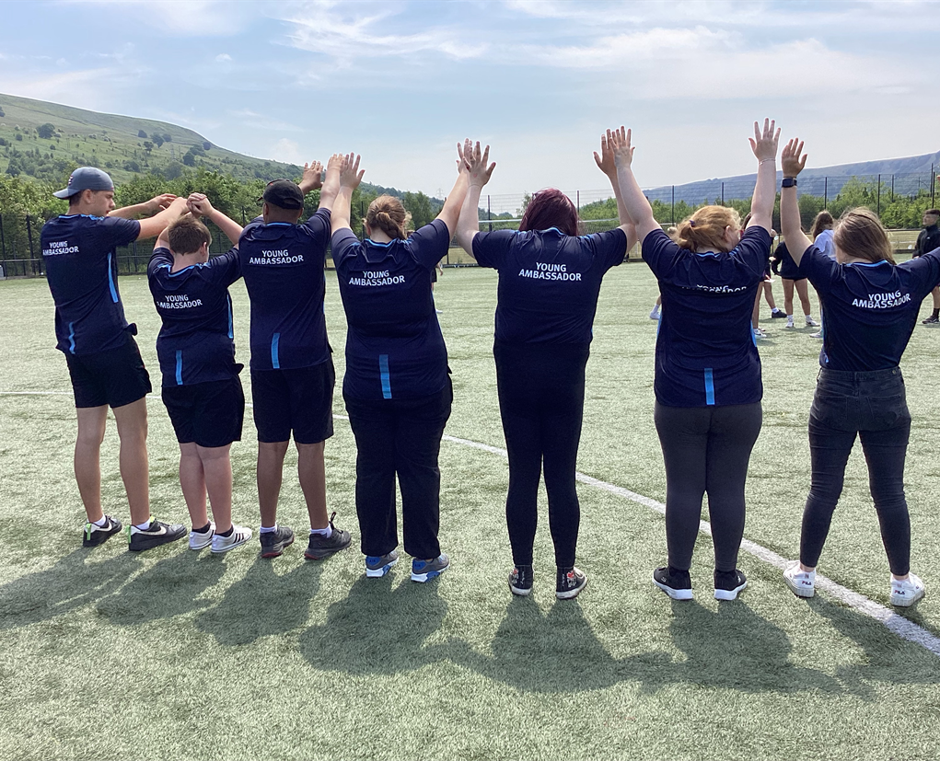
Sports Leaders
The Sports leaders Playmaker programme is an award which helps the learners develop their leadership skills and support younger children with sporting activities. It helps build confidence and works on leadership skills and self-esteem.
The learners challenge themselves, planning tasks and lessons under direct supervision. We have supported events such as athletics, cross country, cricket, the pentathlon and other various events.
The learners are working towards their bronze, silver and gold awards.

Slide 8
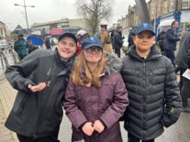
Police Cadets
We have learnt about internet safety, different types of Police vehicles and the Phonetic Alphabet.
This term we are having a visit from the Police dogs, we are all looking forward to this.
Some of our Police Cadets participated in laying a wreath for Remembrance Sunday.

Slide 9
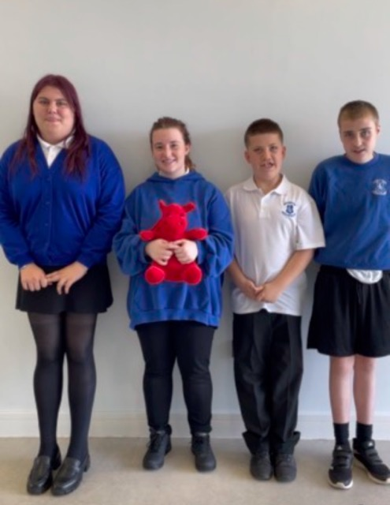
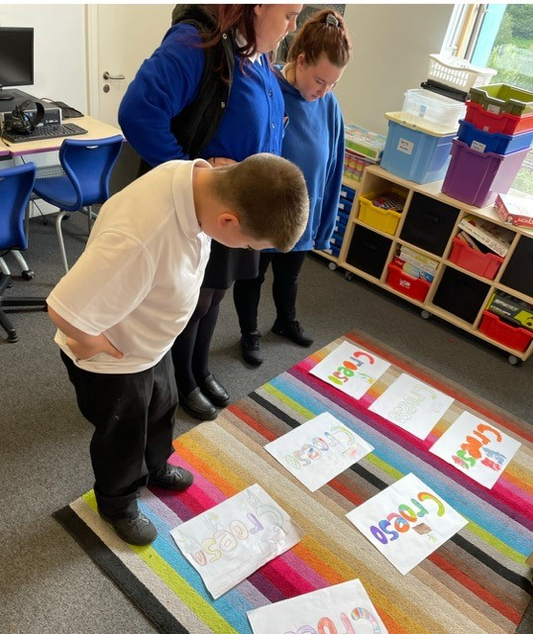
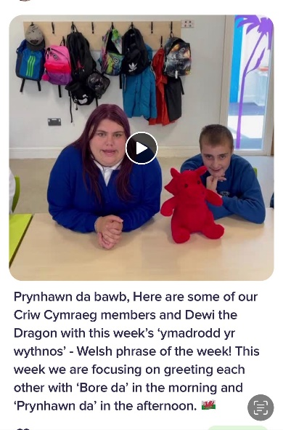
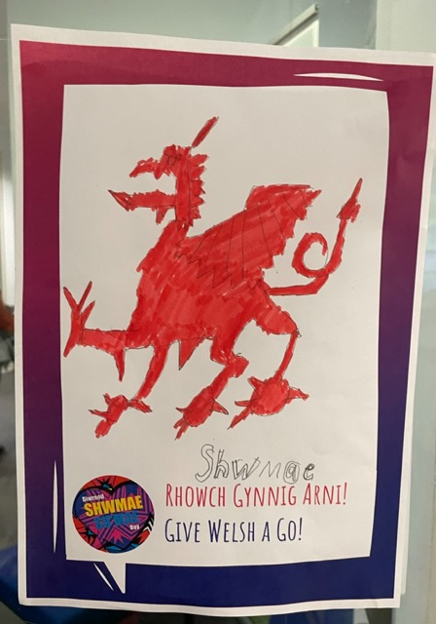
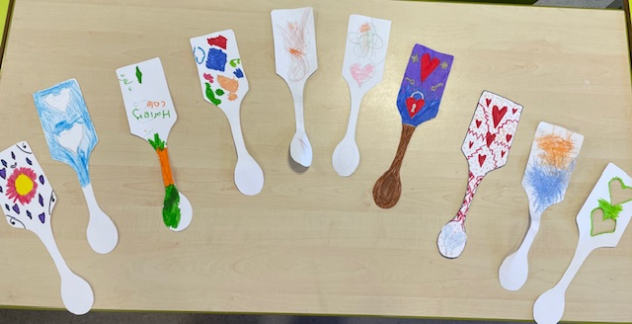
Criw Cymraeg
Established in 2019, Criw Cymraeg continues to play an important role in promoting the use of the Welsh language at Pen-y-Cwm.
Meeting weekly, the Criw shares an ‘ymadrodd yr wythnos’ (phrase of the week) not just with fellow learners but with the wider PyC family via our Dojo space. The Criw has helped raise awareness of special events such as ‘Diwrnod Shwmae’ and has organized a competition for every learner to enter their own ‘croeso’ poster for to adorn their classroom door.
We continue to work towards achieving the Cymraeg Campus Bronze Award, ensuring that Cymraeg plays an integral role in our daily lives.

Slide 10
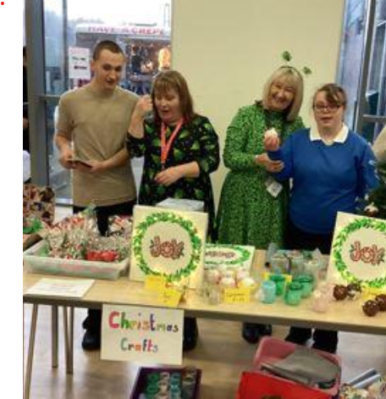
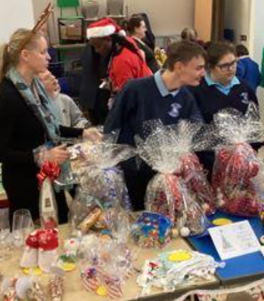
Community Champions
Roles/Responsibilities
Fund raising
Keeping our community clean/recycling
Litter picking
Planting more wild plants
Upcoming events/focus
Plan first fund rising event
Community projects and work experience
Helping and Organising school fairs and fetes.

Slide 11
School Ambassadors and the Senedd
Evidence for work completed is uploaded to Seesaw.
Each sub-committee has appointed an ambassador. These ambassadors form the school Senedd.
We meet together to share work and actions plans with each other and with Senior Leaders regularly.
Next Step:
Share with all pupils and parents.
Add to website.

Slide 12
Thank you for listening.

